Slide 1
Case Study Presentation 5202 Develop functional R code for getting correlation & interaction patterns among different parameters of heart disease patients
Tareque Muzahid Zamee

Slide 2
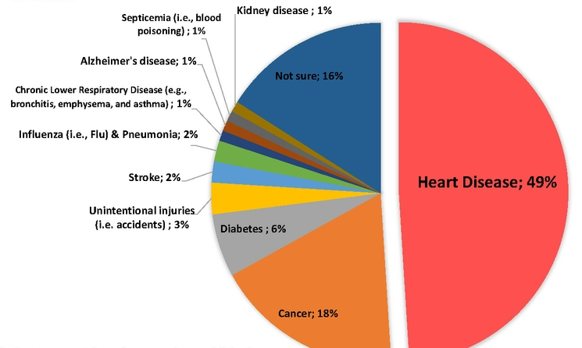
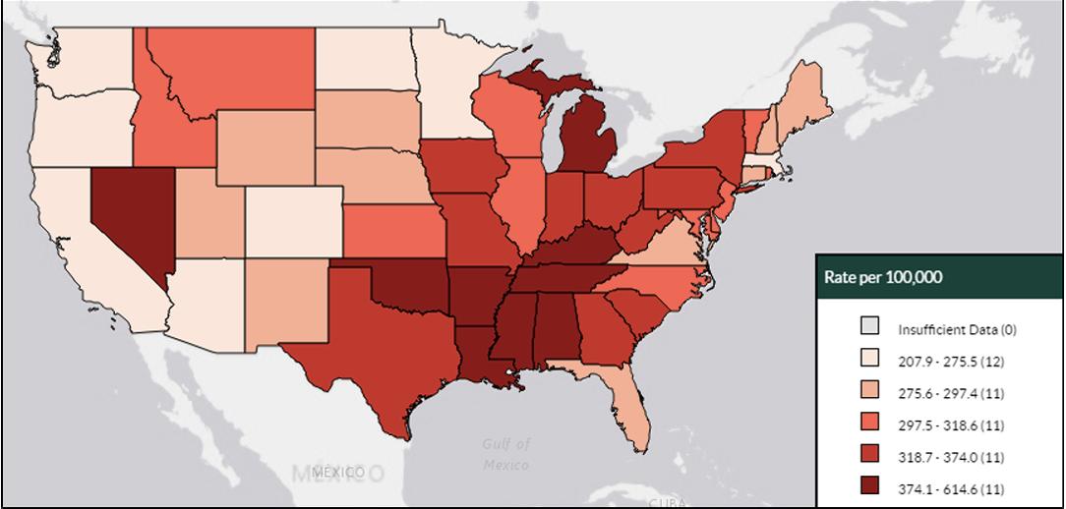
Importance of this case study
In US, someone has a heart attack every 40 seconds
Every year, about 805,000 Americans have a heart attack.
About half of all Americans (47%) have at least 1 of 3 key risk factors for heart disease namely high blood pressure, high cholesterol, and diabetes
American Heart Association. (2018)
Center for Disease Control. (2020a). Interactive Atlas of Heart Disease and Stroke.
Center for Disease Control. (2020b). Blood Pressure.

Slide 3
Research questions
How heart disease is developed based on different parameters (such as- age, sex, blood pressure, serum cholesterol, fasting blood sugar, etc.)?
Is there any correlation and/or interaction patterns among these different parameters?

Slide 4
Case study work flow
Prepare Research QS
Read Research Papers to nevigate on those research QS
Import dataset into R console
Install required packages
Develop functional R code to get plot/graph
Conclusion statements

Slide 5

Packages Utilized

Slide 6
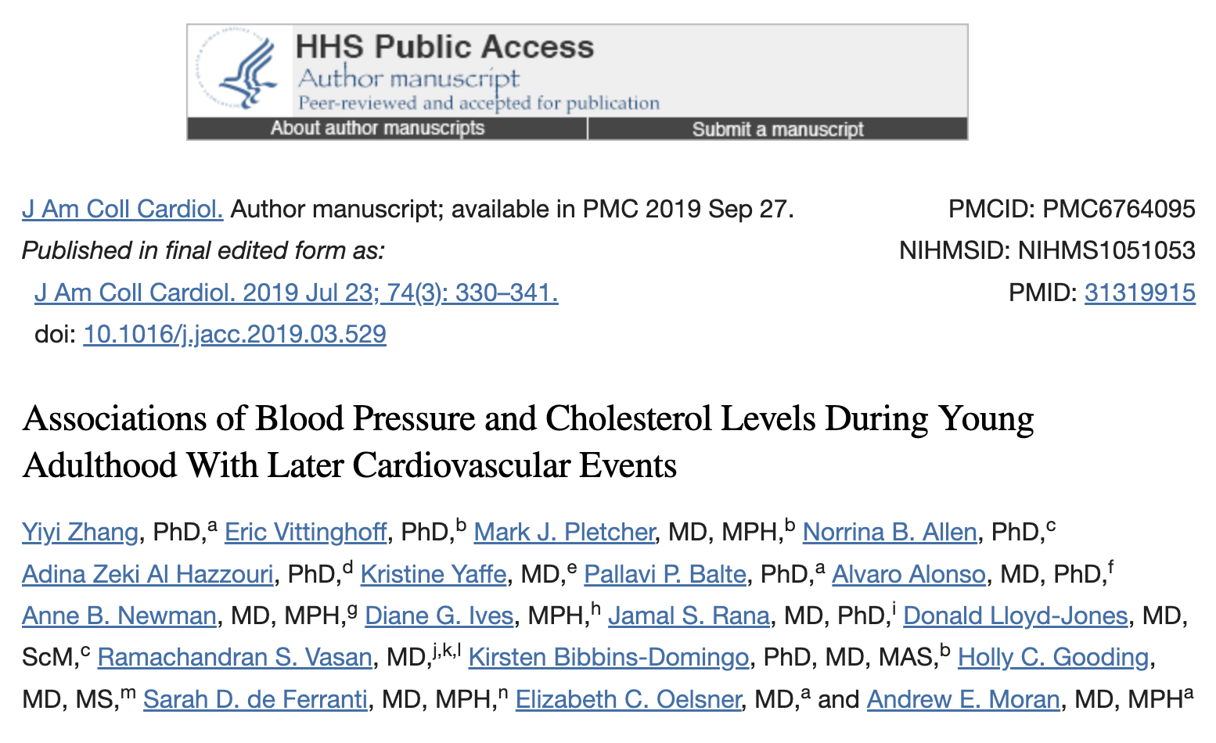

Slide 7
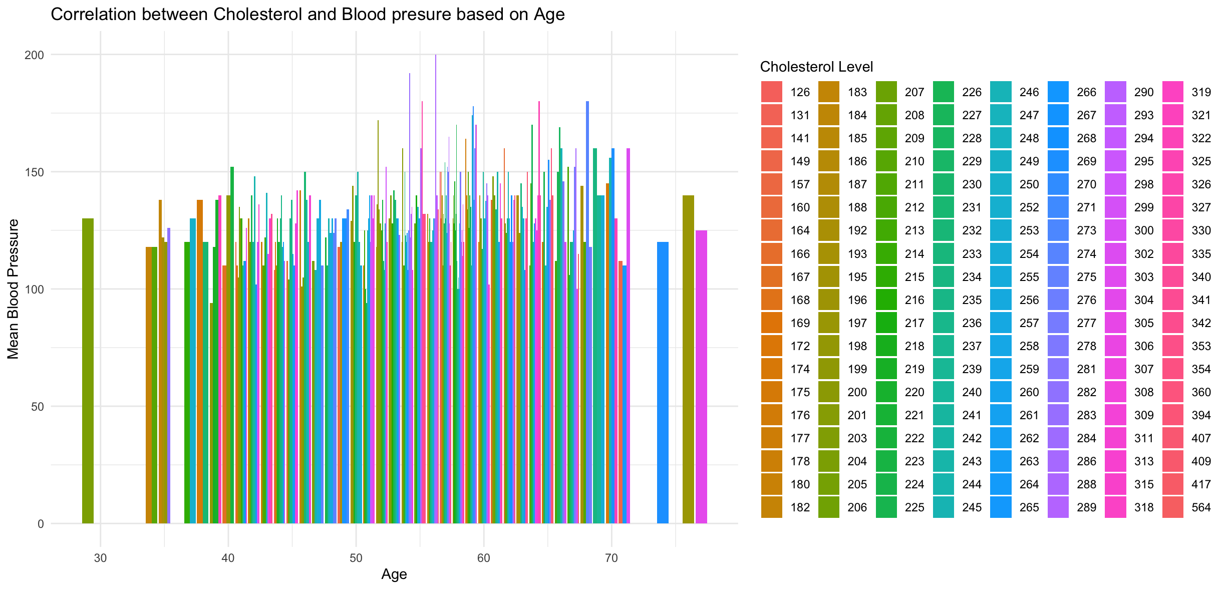
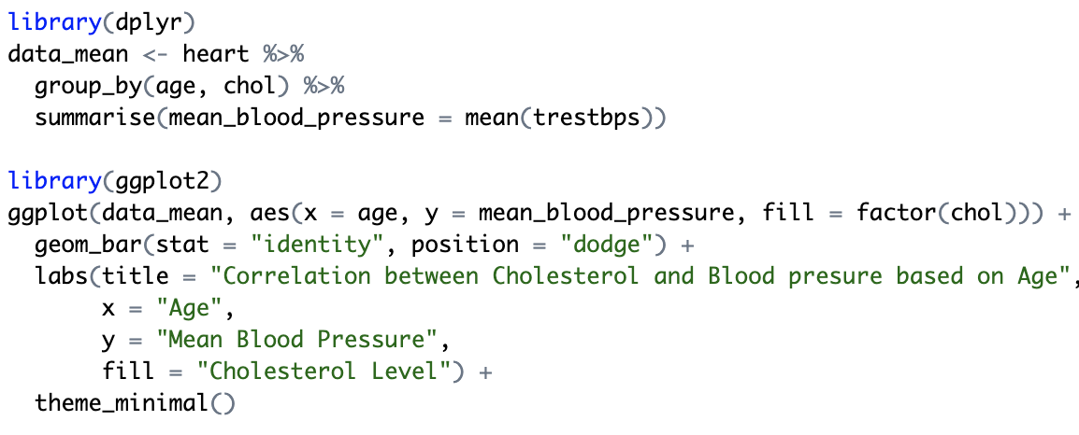

Slide 8
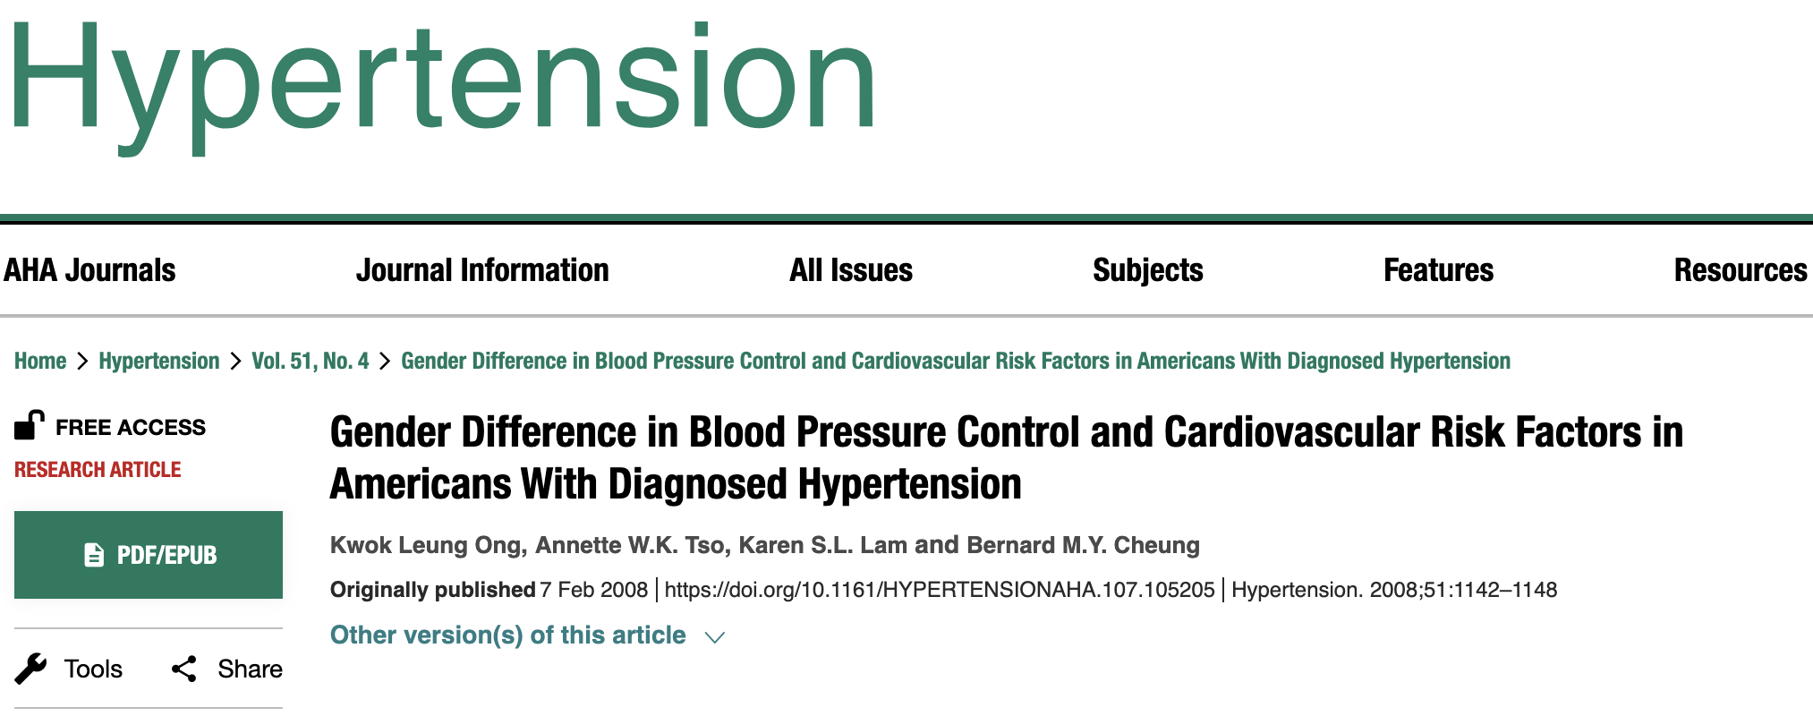

Slide 9
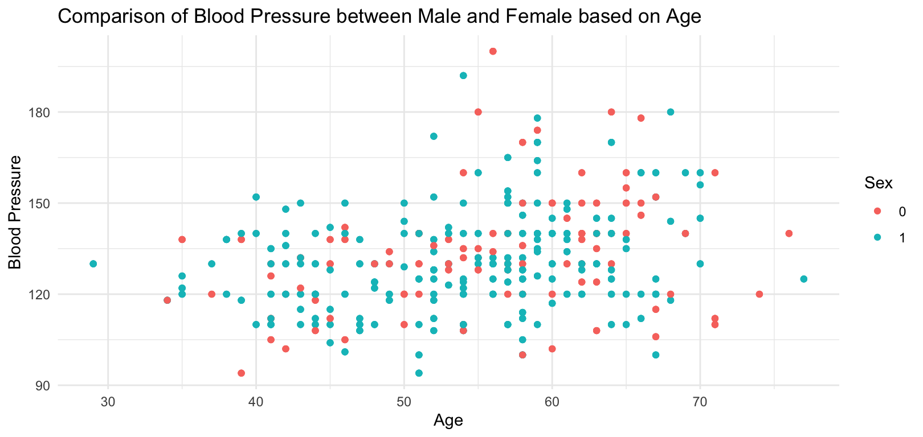
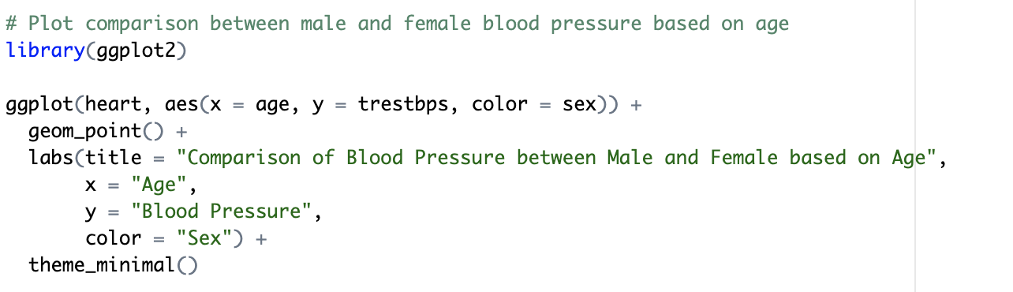

Slide 10
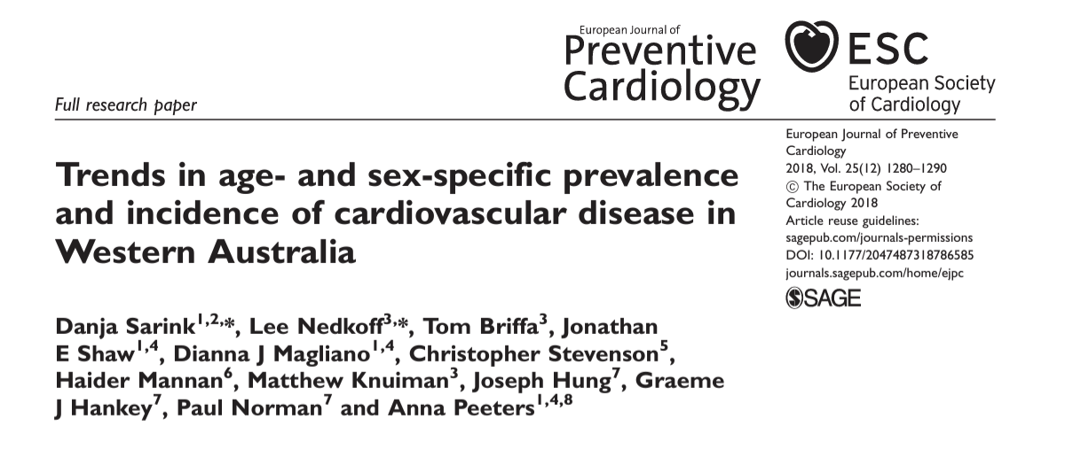

Slide 11
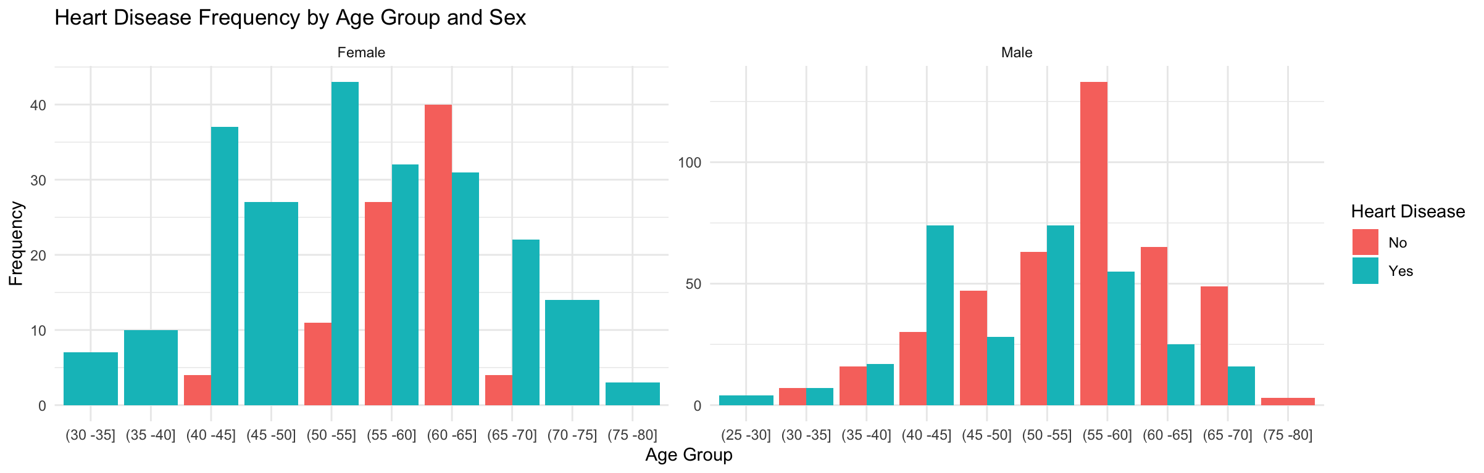
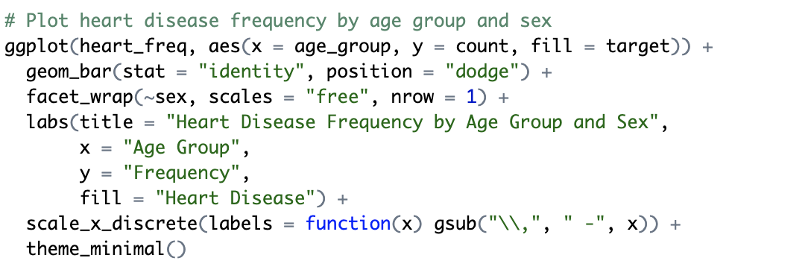
Notes:
gsub() function in R Language is used to replace all the matches of a pattern from a string.
scale_x_discrete() and scale_y_discrete() are used to set the values for discrete x and y scale aesthetics. For simple manipulation of scale labels and limits.
facet_wrap() makes a long ribbon of panels (generated by any number of variables) and wraps it into 2d. This is useful if you have a single variable with many levels and want to arrange the plots in a more space efficient manner.

Slide 12
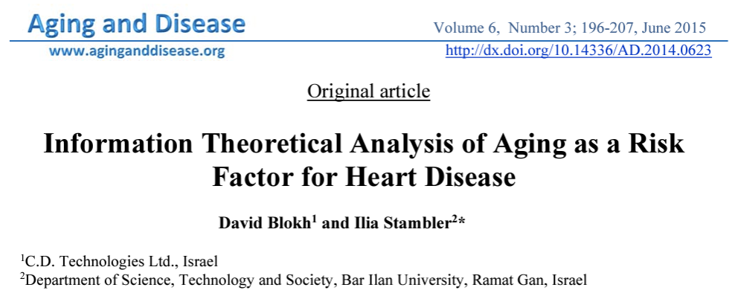
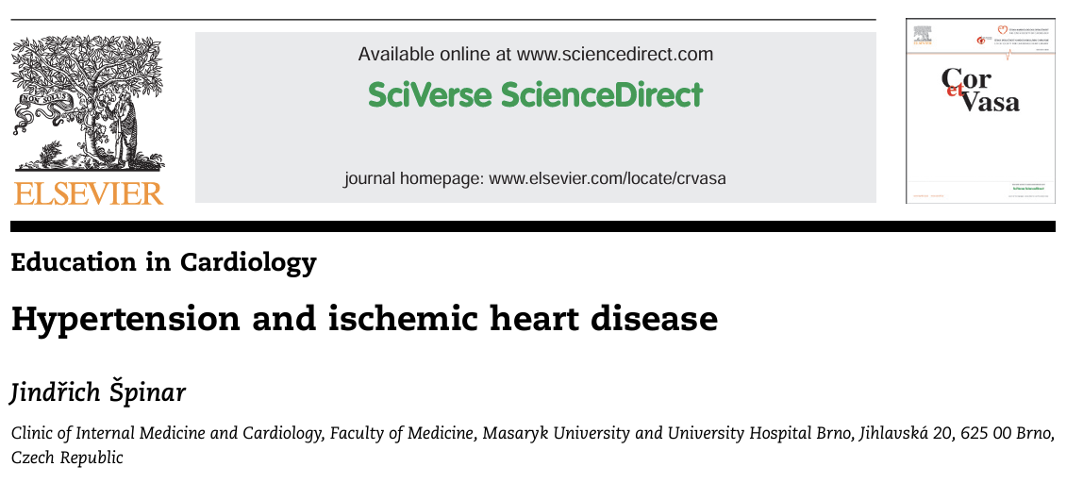

Slide 13
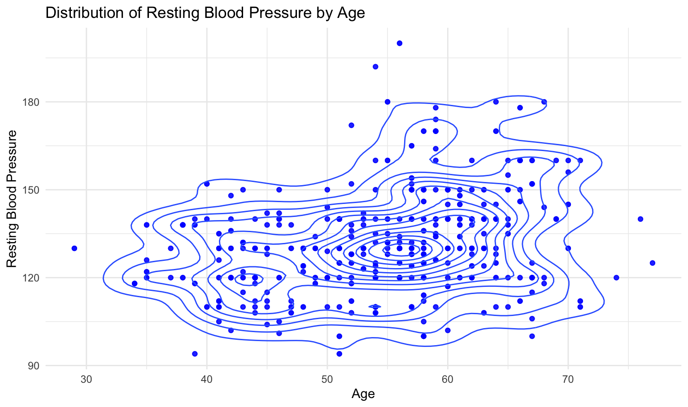
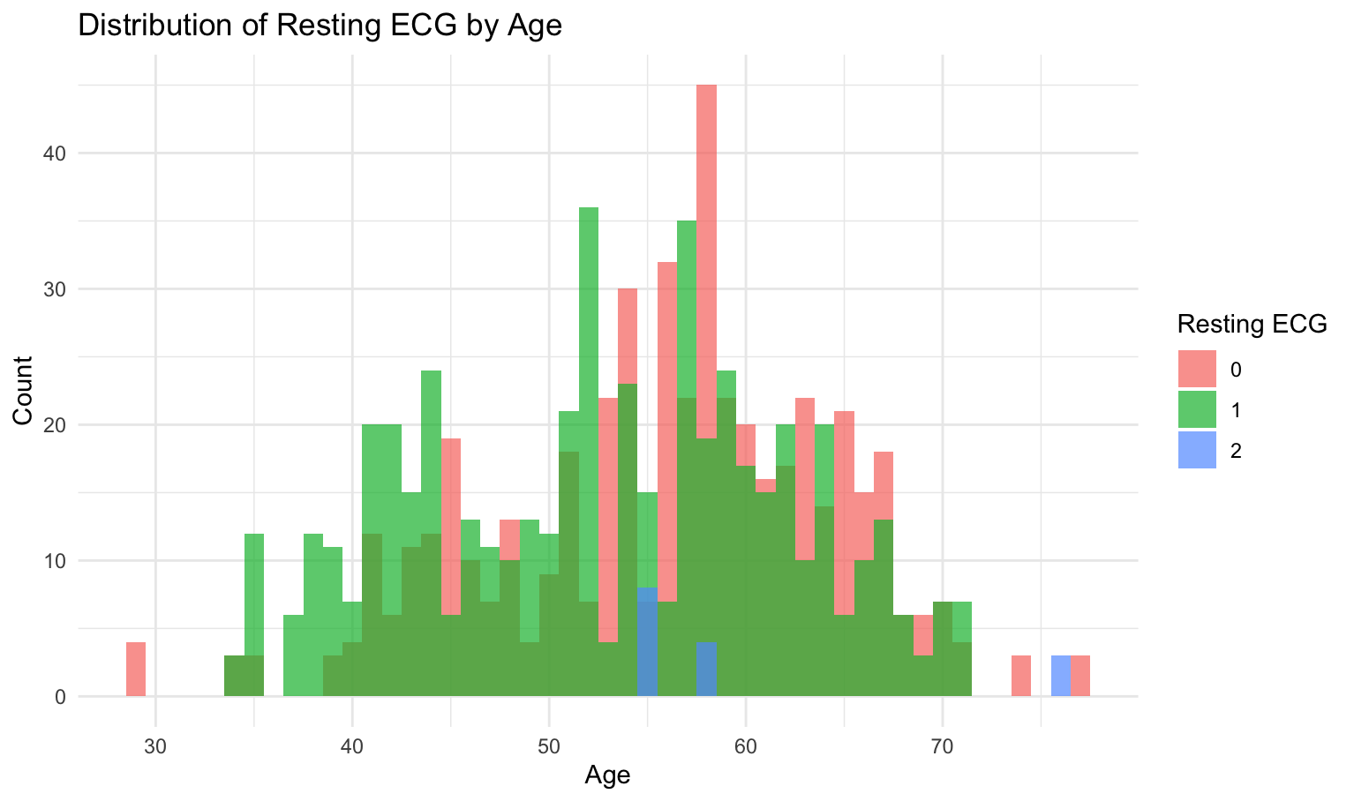
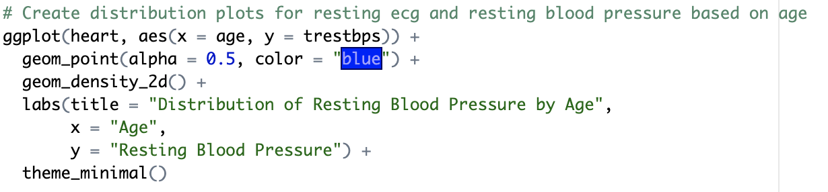
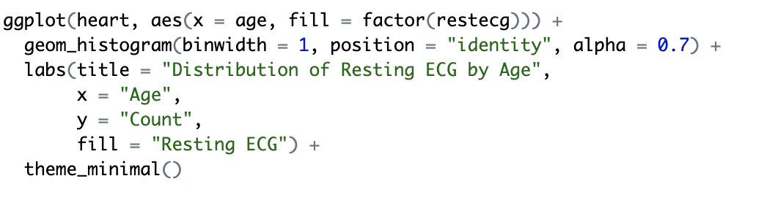

Slide 14
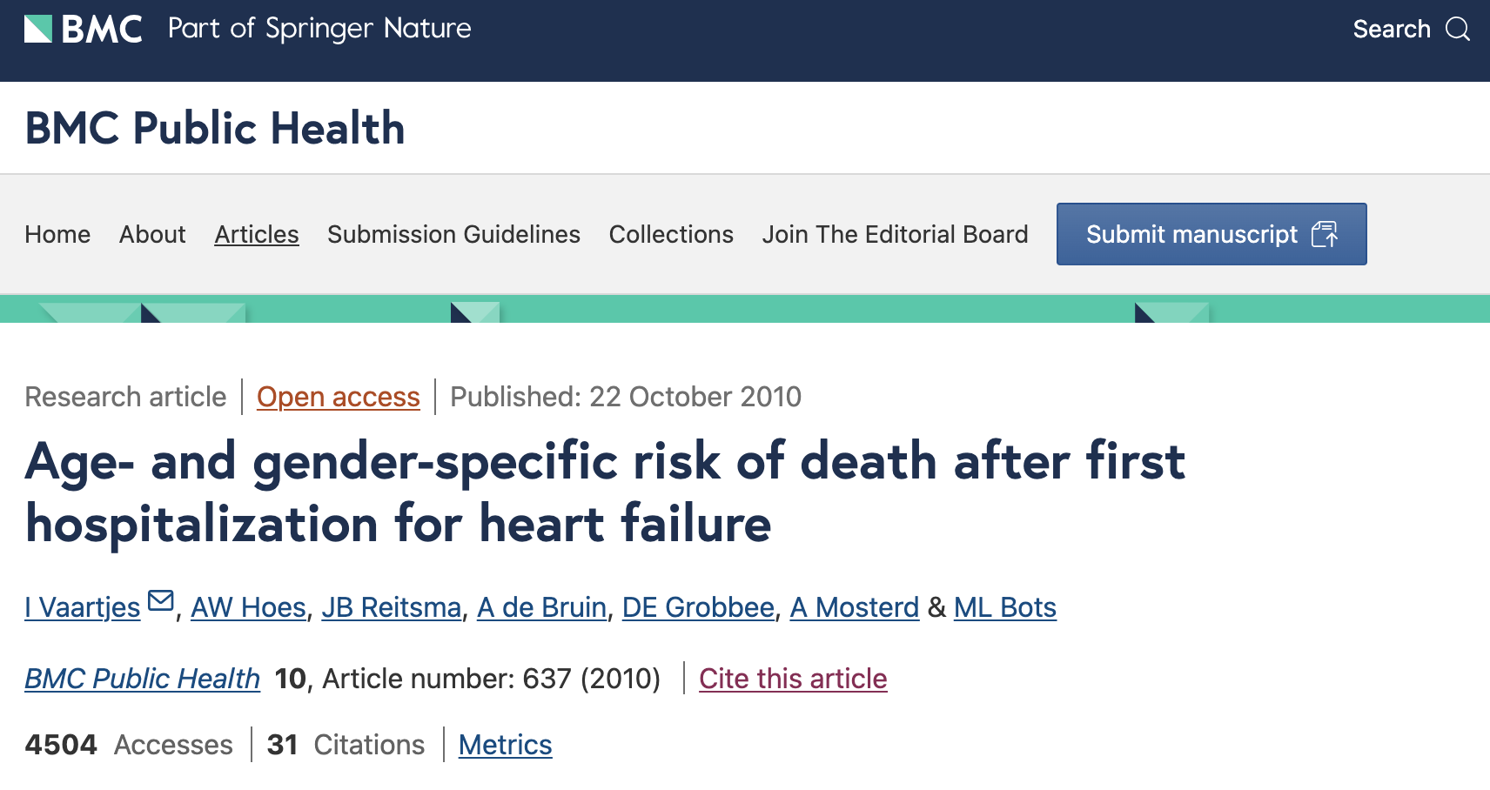
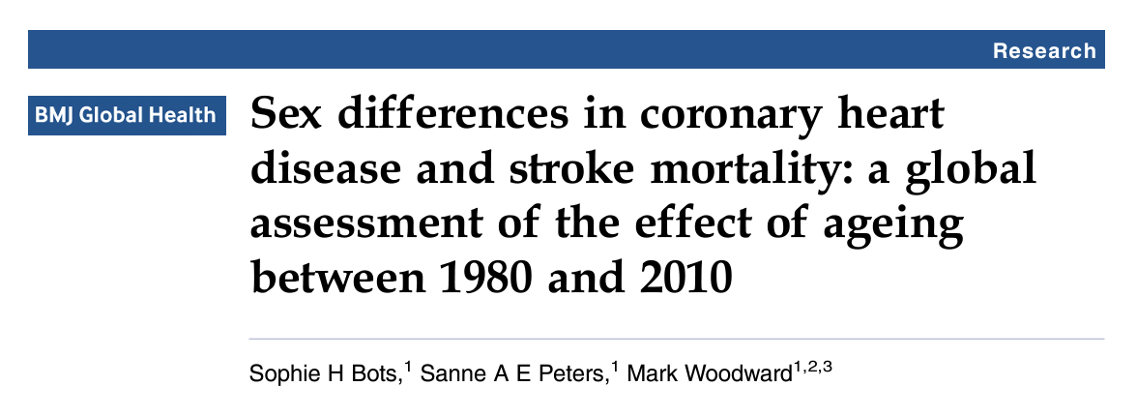

Slide 15
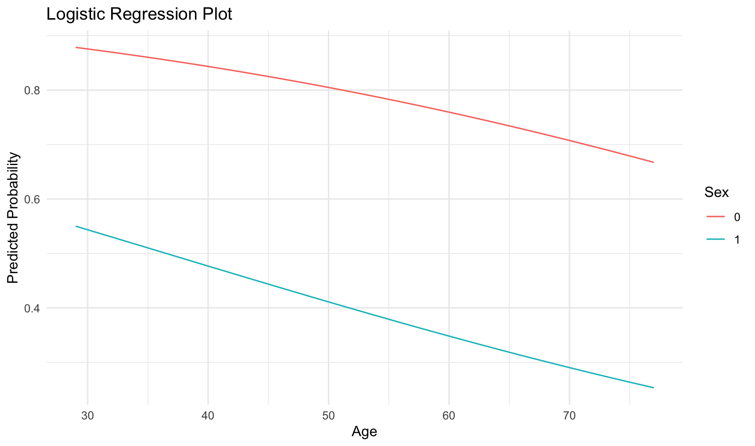
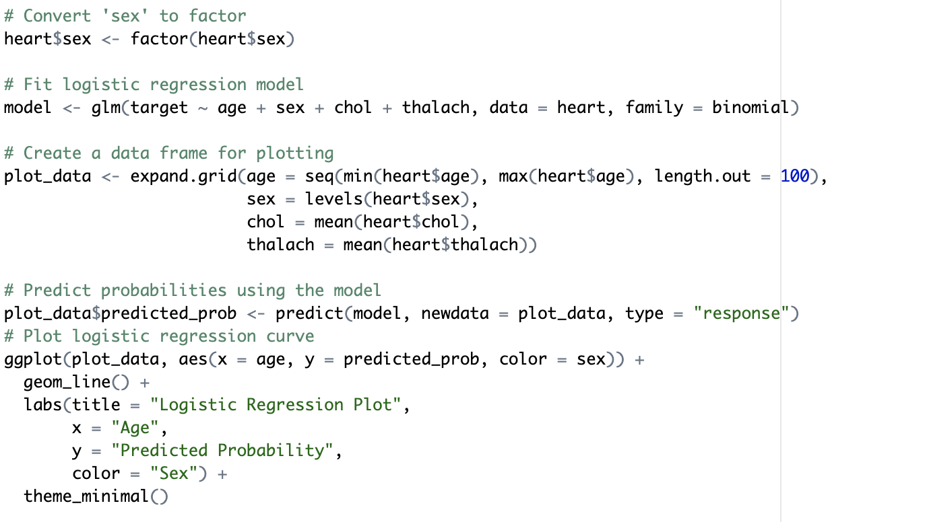
Notes:
glm is used to fit generalized linear models, specified by giving a symbolic description of the linear predictor and a description of the error distribution.
Rakuten:
we use the function labs() to change the main title, the subtitle, the axis labels and captions.

Slide 16
Conclusion
Men are more vulnerable than women as Heart Disease Patients (who are experienced with different other diseases)
Mid age (40-60) heart disease patients have more prone to experience different other complexities
Managing stress and controlled diet are the most important factors for maintaining a healthy life as a heart disease patient

Slide 17
References
Zhang, Y., Vittinghoff, E., Pletcher, M. J., Allen, N. B., Zeki Al Hazzouri, A., Yaffe, K., Balte, P. P., Alonso, A., Newman, A. B., Ives, D. G., Rana, J. S., Lloyd-Jones, D., Vasan, R. S., Bibbins-Domingo, K., Gooding, H. C., de Ferranti, S. D., Oelsner, E. C., & Moran, A. E. (2019). Associations of Blood Pressure and Cholesterol Levels During Young Adulthood With Later Cardiovascular Events. Journal of the American College of Cardiology, 74(3), 330–341. https://doi.org/10.1016/j.jacc.2019.03.529
Danja Sarink, Lee Nedkoff, Tom Briffa, Jonathan E Shaw, Dianna J Magliano, Christopher Stevenson, Haider Mannan, Matthew Knuiman, Joseph Hung, Graeme J Hankey, Paul Norman, Anna Peeters, Trends in age- and sex-specific prevalence and incidence of cardiovascular disease in Western Australia, European Journal of Preventive Cardiology, Volume 25, Issue 12, 1 August 2018, Pages 1280–1290, https://doi.org/10.1177/2047487318786585
Špinar, J. (2012). Hypertension and ischemic heart disease. Cor et Vasa, 54(6), e433-e438. https://doi.org/10.1016/j.crvasa.2012.11.002
Blokh, D., & Stambler, I. (2015). Information theoretical analysis of aging as a risk factor for heart disease. Aging and disease, 6(3), 196–207. https://doi.org/10.14336/AD.2014.0623
Vaartjes, I., Hoes, A., Reitsma, J. et al. Age- and gender-specific risk of death after first hospitalization for heart failure. BMC Public Health 10, 637 (2010). https://doi.org/10.1186/1471-2458-10-637
Bots, S. H., Peters, S. A. E., & Woodward, M. (2017). Sex differences in coronary heart disease and stroke mortality: a global assessment of the effect of ageing between 1980 and 2010. BMJ global health, 2(2), e000298. https://doi.org/10.1136/bmjgh-2017-000298
Masenga, S. K., & Kirabo, A. (2023). Hypertensive heart disease: risk factors, complications and mechanisms. Frontiers in cardiovascular medicine, 10, 1205475. https://doi.org/10.3389/fcvm.2023.1205475
Rodgers, J. L., Jones, J., Bolleddu, S. I., Vanthenapalli, S., Rodgers, L. E., Shah, K., Karia, K., & Panguluri, S. K. (2019). Cardiovascular Risks Associated with Gender and Aging. Journal of cardiovascular development and disease, 6(2), 19. https://doi.org/10.3390/jcdd6020019
Jung, E., Kong, S. Y., Ro, Y. S., Ryu, H. H., & Shin, S. D. (2022). Serum Cholesterol Levels and Risk of Cardiovascular Death: A Systematic Review and a Dose-Response Meta-Analysis of Prospective Cohort Studies. International journal of environmental research and public health, 19(14), 8272. https://doi.org/10.3390/ijerph19148272
https://www.kaggle.com/datasets/johnsmith88/heart-disease-dataset?resource=download
R for Data Science. Wickham and Grolemund. 2023 (https://r4ds.hadley.nz/)
R Core Team. 2024. R: A Language and Environment for Statistical Computing. https://www.r-project.org/

Slide 18


